Slide 1
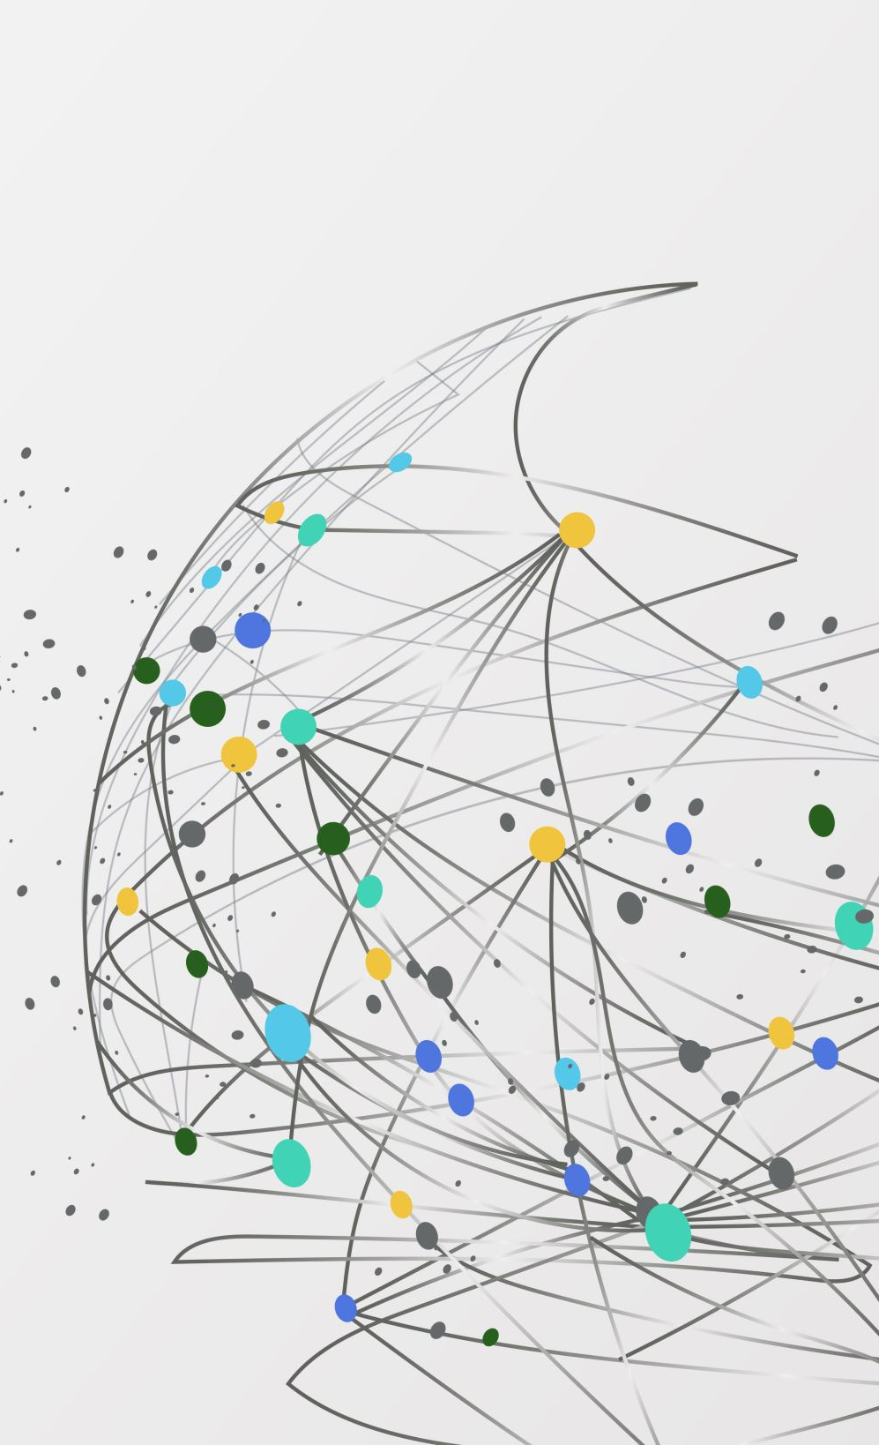
Optimizing Energy Consumption in Smart Homes Using Machine Learning
-Yehang Rai
-Matthew Landrum
-Hans Holmes

Slide 2

Research Question and Hypothesis
Research Question:
Can a machine learning model accurately predict energy consumption in smart homes, and can it be used to optimize energy usage to reduce waste and costs?
Hypothesis:
Historical energy consumption data can be used to predict energy usage patterns, allowing smart homes to optimize appliance use and reduce unnecessary consumption.

Slide 3

Data and Methodology
Dataset:
Source: UCI Machine Learning Repository – "Individual household electric power consumption."
Data Fields: Energy consumption (Global_active_power, Sub_metering_1, 2, 3).
Methodology:
Data Preparation: Clean, preprocess data, and perform exploratory data analysis.
Model Building: Train Random Forest and XGBoost models to predict energy usage.
Evaluation: Use MAE and RMSE to measure accuracy and optimize predictions.

Slide 4
Importance
Importance:
Cost Savings: Helps homeowners reduce energy bills.
Sustainability: Reduces unnecessary energy usage, supporting environmental goals.
Success Criteria:
Achieving accurate predictions with low MAE and RMSE.
Identifying key patterns for optimizing energy consumption and reducing waste.

